Slide 1


Hospital Bed Prediction
Akshita

Slide 2
Table of contents
Introduction
Problem Statement
Flow
Data Set Used
Assumptions
Model Training
Conclusion

Slide 3
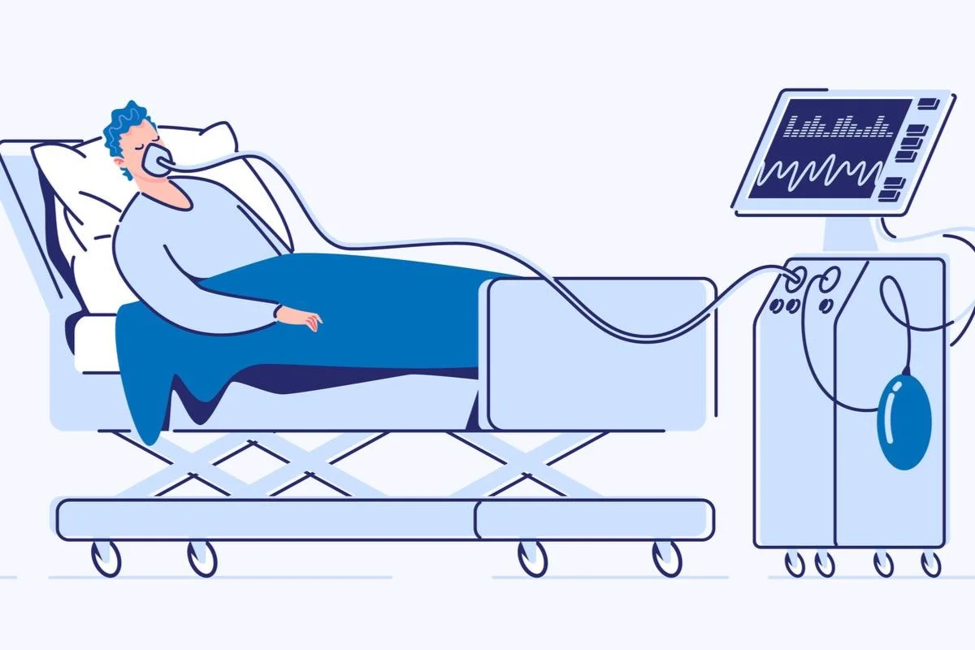
Introduction
The goal is to enhance the operation process and improve efficiency in the health-care industry.
Cincinnati Children’s Hospital
Yale New Haven Hospital

Slide 4
Problem Statement
To develop an algorithm which predicts the availability hospital beds on a certain day and at a certain time.
1. Wanted to concentrate on
Notes:
Due to the recent pandemic, we have seen the importance of hospital beds.

Slide 5

Flow
Predict the number of Covid cases in Maharashtra, Andhra Pradesh, Karnataka.
Derive the number of hospital beds needed in each of the following states.
Predict number of people discharged on a daily basis
Check if the beds are enough to meet their demand.
Notes:
Due to the recent pandemic, we have seen the importance of hospital beds.

Slide 6
Data Sets Used

Slide 7
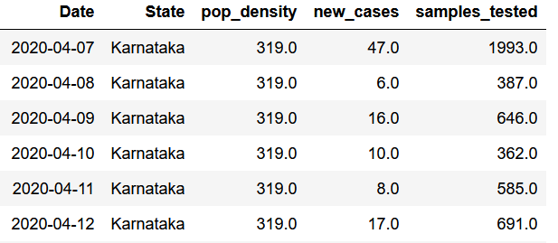
State-wise Features
Contains all the states in India
Total entire 1679 entries
Training set: 7th April – 22rd May
Testing set: 23th May – 4th June
Andhra Pradesh, Maharashtra, Karnataka

Slide 8
Karnataka
Centre of data lies at a mean of 5805.186
Skewness of data: 0.0836481 (towards the right side)
Presence of outliers: None
Type of probability distribution that the data follows: Not a specific type

Slide 9
Andhra Pradesh
Centre of data: 7489.691
Skewness of data: 0.010923
Presence of outliers: 1 outlier present
Type of probability distribution that the data follows: Normal Distribution

Slide 10
Maharashtra
Centre of data: 8509.879
Skewness of data: -0.44943(left-side)
Presence of outliers: 1 outlier present
Type of probability distribution that the data follows: Not a specific type

Slide 11
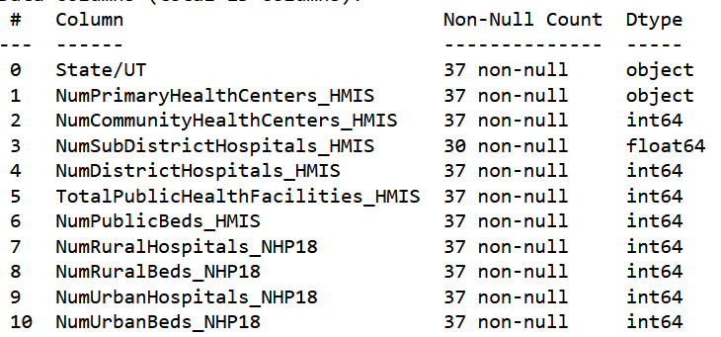
Beds In India
This information is present for each state.
Features are added to create the total number of beds.
37 entries for each state
Notes:
Can the next slide be applied to this dataset?

Slide 12

Assumptions
65% of the people who have tested positive will require hospitalization.
2% of the beds will be available to new Covid patients.
70% of people will be discharged within 10 days of hospitalization.
Notes:
Identify the features.. Implementented
mathematical equals using model
Errors in terms of percentage
problem statement

Slide 13
Model training
Outliers were found using Z-score
The data was split into two sets: Training and Testing sets
4 models were performed on the training set:
Linear Regression
Polynomial Regression
Decision Tree Regression
Support Vector Machine Regression
Cross Validation was performed for all of them.
The model with the highest cross-validation score is performed on the test set.

Slide 14
Model training
The bed dataset gives us the maximum number of datasets available to each state at all times.
Thus, after a day or two, the dataset doesn’t give us the beds that are available.
On an average, a covid patient will be discharged within 10-15 days of hospitalization.
So assuming that 70% of people are released in 10 days and we predict the number of people discharged.
Finally add this number daily.

Slide 15
Conclusion
 | MAHARASTRA |  | KARNATAKA |  | ANDHRA PRADESH
MODEL | VALIDATION R2 METRIC | ACCURACY TEST | VALIDATION R2 METRIC | ACCURACY TEST | VALIDATION R2 METRIC | ACCURACY TEST
Linear Regression | 0.727004256 | 937349.6758 | 0.023193711 | 16490.29379 | 0.273983139 | 386.9787107
Polynomial Regression | 0.756700699 | 122541.9987 | 0.563331177 | 17191.40576 | 0.309124321 | 612.9804387
SVM Regression | 0.748668644 | 661129 | 0.278155836 | 46628.17131 | 0.28926951 | 5107.98996
DT Regression | 0.643621244 | 6438538.815 | -0.41520561 | 17386.41667 | 0.054603031 | 612.8080808

Slide 16
Conclusion Bed availability
Andhra Pradesh
1674.45701111
1667.80445795
1658.89635797
1647.58808399
1633.73636418
1617.19928213
1597.83627676
1575.5081424
1550.07702874
1521.40644084
1489.36123914
1387.65127591
Karnataka
2446.27481427
2353.3608405
2250.65818976
2137.54900425
2013.39745732
1877.5497534
1729.33412807
1568.06084804
1393.02221112
1203.49254627
998.72821356
777.96760419
Maharashtra
1948.4710794
1472.51417071
980.31980795
471.03256527
-56.24894302
-602.47206245
-1168.63
-1755.76231605
-2364.953
-2997.33
-3654.086
-4336.426

Slide 17
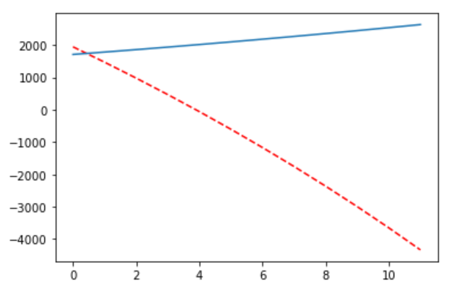
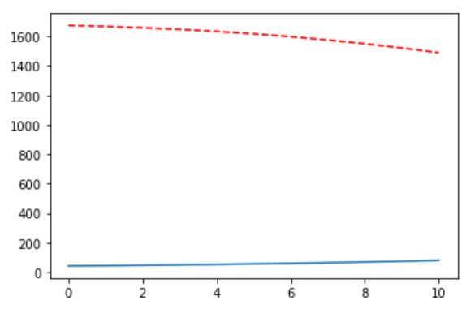
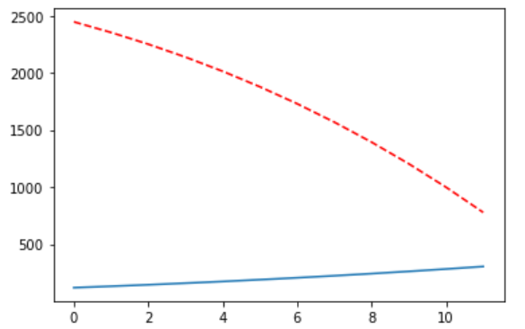
Maharashtra
Andhra Pradesh
Karnataka

Slide 18
Difficulties
Finding a dataset directly related to the this topic was difficult.
Checking if the day by day prediction is correct

Slide 19
Future Ideas
Implementing Artificial Neutral Network to make the better predictions.
Finding out different methods to make predictions better.

Slide 20
Thank you

